Slide 1

Lead Scoring Case Study
Submitted By
Abhishek Rathore
Abhisek Kundu
Abhradeep Chandra Paul

Slide 2
Problem Statement
Company: X Education sells online courses to industry professionals.
Process: Interested professionals fill out a form on the website and become leads.
Current Conversion Rate: 30% (only 30 out of 100 leads convert).
Goal: Identify "Hot Leads" to improve efficiency.
Objective:
Build a model to score each lead between 0-100.
Focus sales efforts on high-potential leads.
Increase conversion rate to 80%.
Requirements:
Handle future constraints.
Optimize peak time actions.
Utilize full manpower efficiently.
Adapt post-target achievement strategies.
Making targeted efforts should boost conversion and streamline the sales process!

Slide 3
Approach
Data Preparation
Exploratory Data Analysis (EDA)
Dummy Variable Creation
Train-Test Split
Feature Scaling
Correlation Analysis
Model Building
Recursive Feature Elimination (RFE)
R-squared, VIF, and p-values
Model Evaluation
Threshold Tuning
Precision and Recall Evaluation
Making Predictions on Test Set

Slide 4
Data Preparation
Data Insights
Number of Rows and Columns: 9,240 rows, 37 columns
Duplicates: No duplicate rows found
Data Types: 7 numeric columns, 30 non-numeric columns
Null Handling: 'Select' values were converted to null as per the problem statement
Cleaning of categorical data
Columns Deleted ( > 40% Null Data)
Lead Quality
Lead Profile
Asymmetrique Activity Index
Asymmetrique Profile Index
How did you hear about X Education
Columns Dropped (Insignificant Data):
What matters most to you in choosing a course
Country
Null Data is filled with “Other”
What is your current occupation
Specialization
Null data filled with Major category
City
Tags
Cleaning of Numerical Data
Columns Deleted ( > 40% Null Data):
Asymmetrique Activity Score
Asymmetrique Profile Score
Handling Null Rows:
Null rows were deleted where data is relatively small for:
TotalVisits
Page Views Per Visit

Slide 5
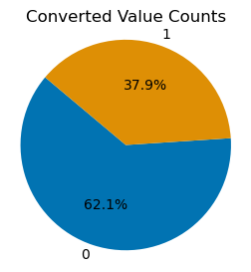
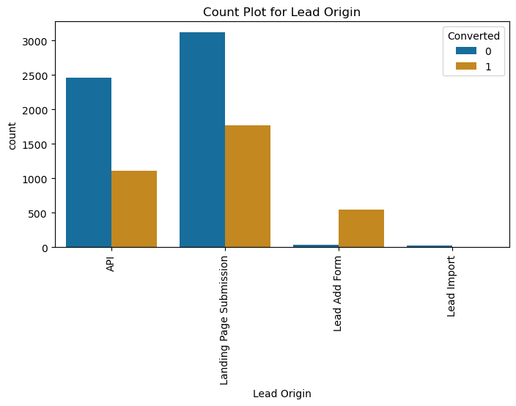
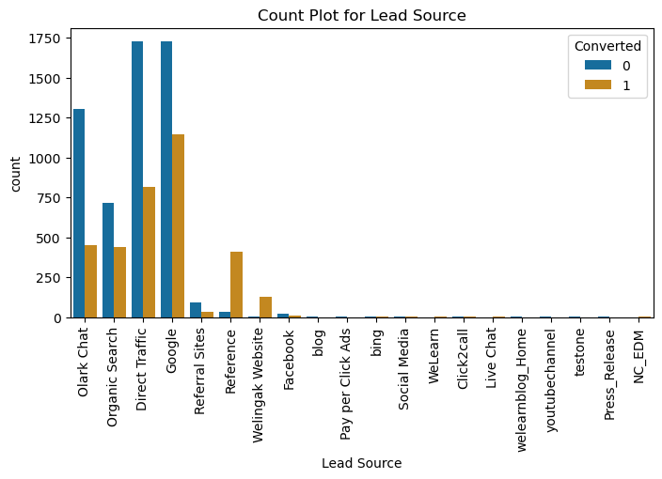
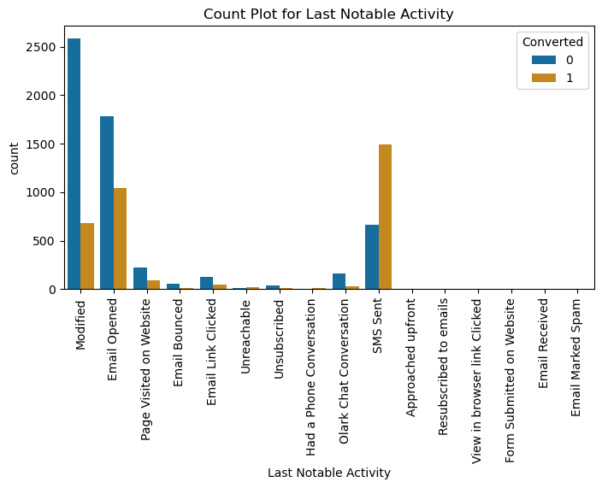
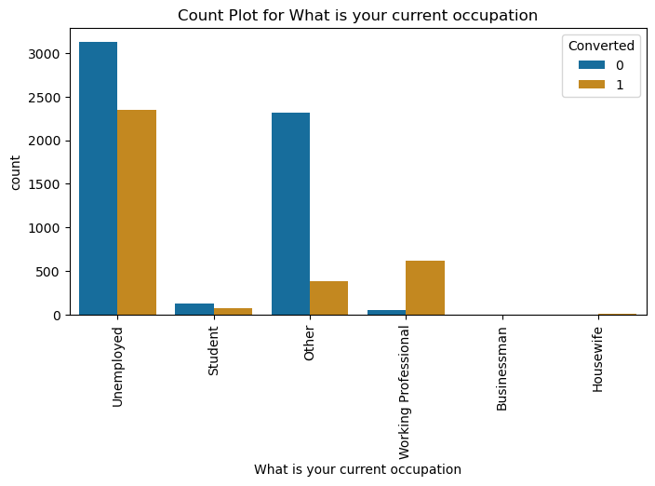
EDA
Non Numeric Data Bivariate Analysis: Major Highlights
API and Landing Page Submissions have 30-35% conversion rates with high lead counts
Improve conversions for Olark Chat, Organic Search, Direct Traffic, and Google leads. Generate more leads from Reference and Welingak Website.
Target Variable
Columns Removed since no inference can be drawn
Tags
Search
Magazine
Newspaper Article
X Education Forums
Newspaper
Digital Advertisement
Through Recommendations
Receive More Updates About Our Courses
Update me on Supply Chain Content
Get updates on DM Content
I agree to pay the amount through cheque
A free copy of Mastering The Interview
SMS Sent has high conversion
Working Professionals going for the course have high chances of joining it

Slide 6
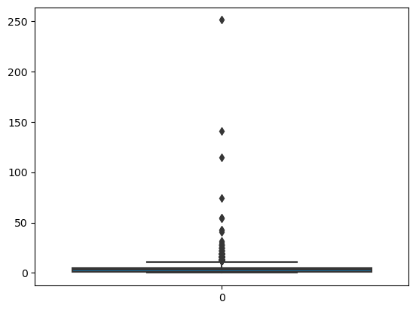
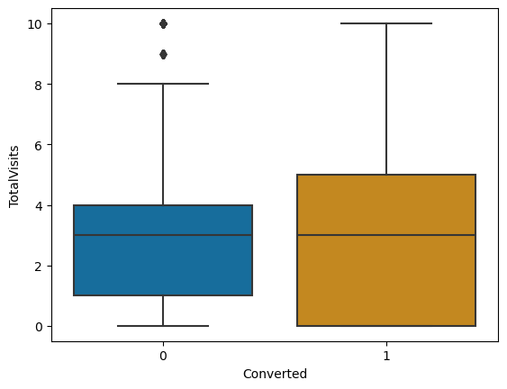
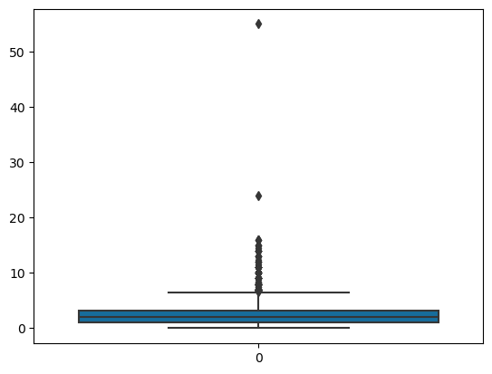
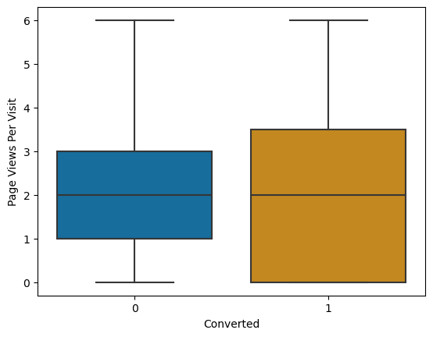
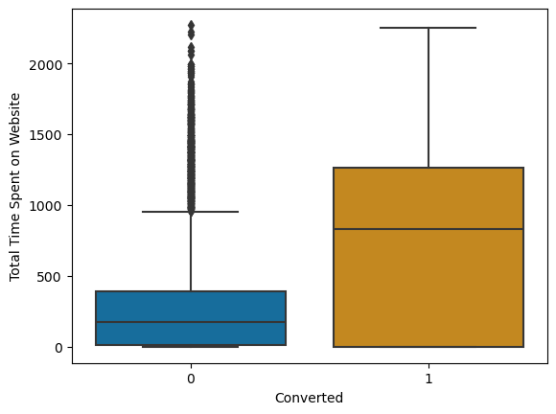
EDA
Numeric Data Bivariate Analysis
TotalVisits
Page Views Per Visit
Removing Outliers
Leads converted more when spending more time on website. Make site engaging to boost conversions
Target Variable
No conclusion on Data
Medians values were same
TotalVisits
Lead Number
Page Views Per Visit

Slide 7
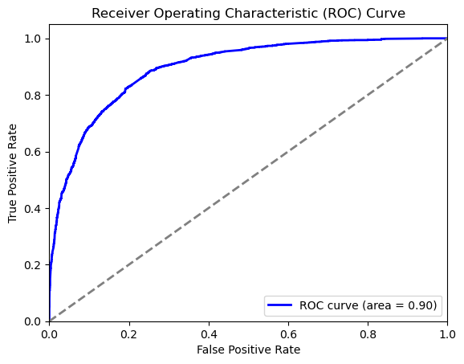
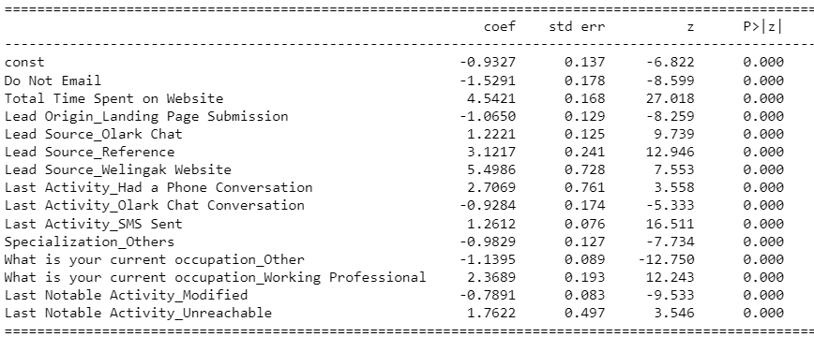
Model Evaluation
Final Model after RFE, Pvalue and VIF analysis
P=0
Confusion Matrix:
[[3467 438]
[ 724 1722]]
Sensitivity: 0.7040065412919051
Specificity: 0.8878361075544174
False Positive Rate: 0.11216389244558259
Positive Predictive Value: 0.7972222222222223
Accuracy: 0.8170366871358841
Given our model's high ROC AUC score of 0.90, it demonstrates excellent performance and reliability.

Slide 8
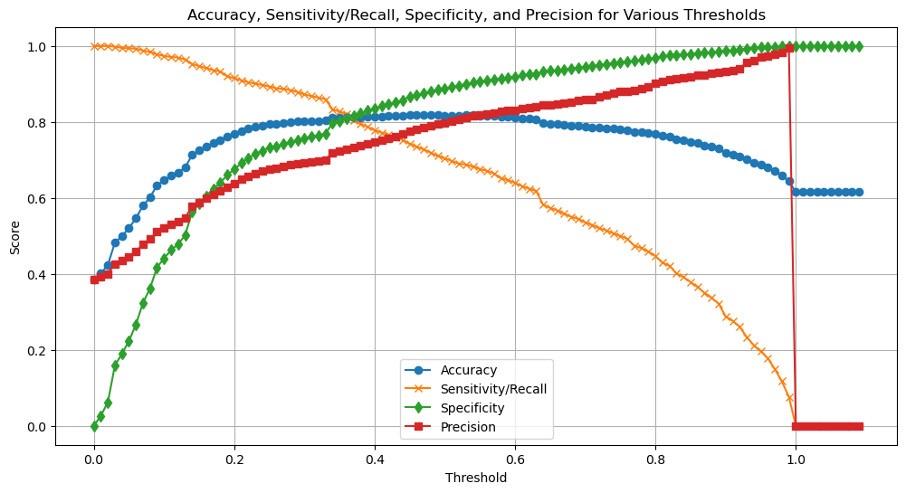
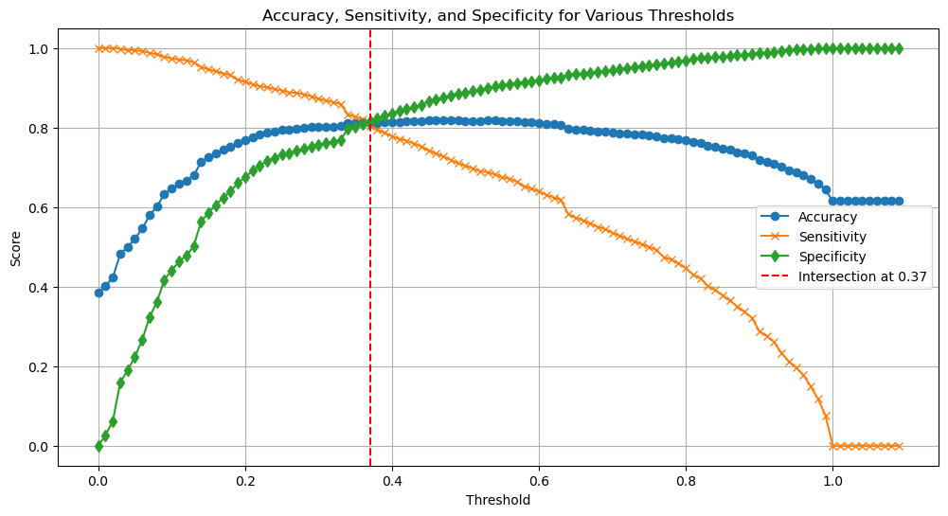
Model Evaluation
Threshold Tuning: Experiment with different probability thresholds to find the best balance between sensitivity and specificity
Precision and recall tradeoff :
The Precision-Recall trade-off reduced True Positives and increas7ed True Negatives. For better recall and increased True Positives, we chose 0.3 as the optimal cutoff point.
Intersection Threshold: 0.37
Accuracy at Intersection: 0.8110533774208786
Sensitivity at Intersection: 0.8045789043336059
Specificity at Intersection: 0.8151088348271447

Slide 9
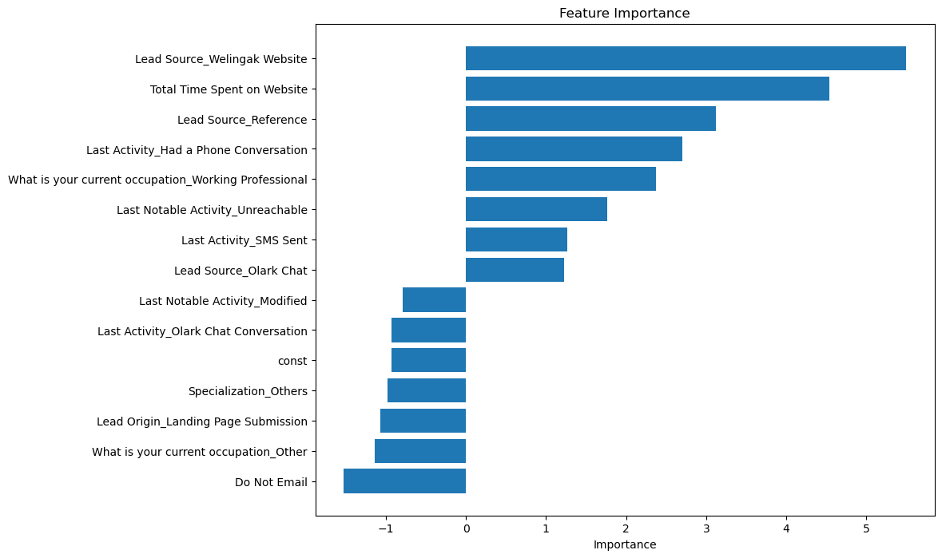
Conclusion
Recommendations based on Prediction
Call Priority Leads:
Leads from "Welingak Websites" and "Reference" sources are highly likely to convert.
Working professionals show a higher conversion likelihood.
Leads who spend more time on the website are promising candidates.
Leads from "Olark Chat" are more likely to convert.
Leads whose last activity was SMS Sent are promising.
Leads having Phone conversion are promising candidates
Avoid Calling:
Leads whose last activity was "Olark Chat Conversation" are less likely to convert.
Leads from "Landing Page Submission" origin are not likely candidates.
Leads with "Specialization: Others" show lower conversion rates.
Leads who selected "Do not Email" as "yes" are less likely to convert.
Train Data:
Accuracy : 81.1%
Sensitivity: 80.5%
Specificity: 81.5%
Test Data:
Accuracy : 80.9%
Sensitivity:79.1%
Specificity : 81.9%

